Slide 1
IS 120
CSS Grid

Slide 2
Announcements
HW6 will be posted after class
  Flexbox Froggy and Grid Garden
  Mid-Semester Survey
  Watch Flexbox vs Grid video
Project 1 feedback will be coming this week

Slide 3
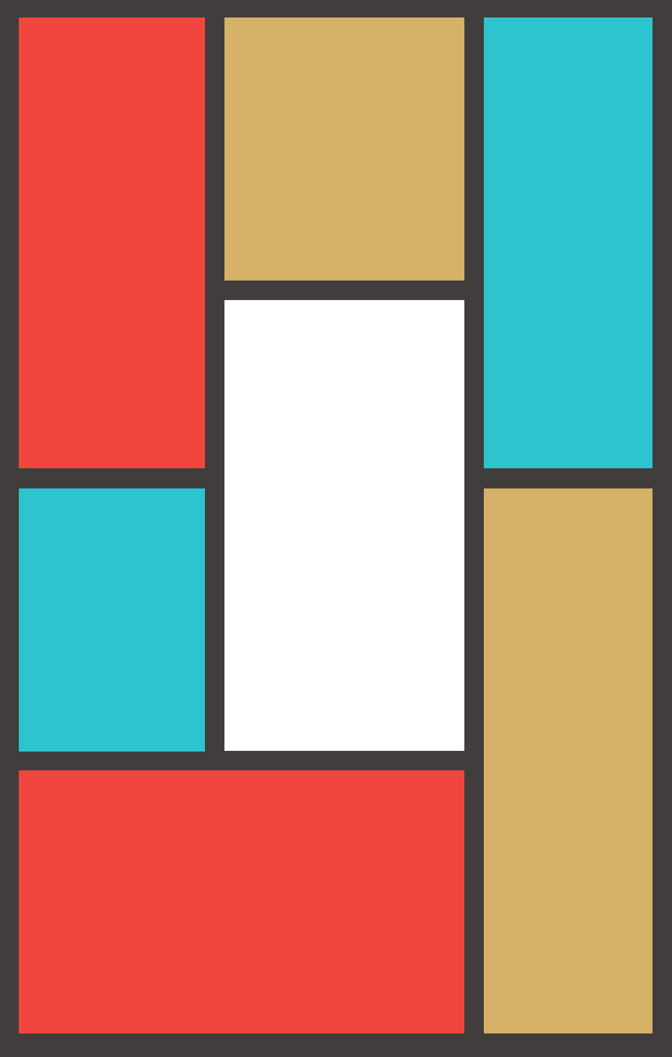
What is Grid?
Grid is a 2-dimensional layout system
Control row and column layout at the same time
Highly customizable, but can get complex fast

Slide 4
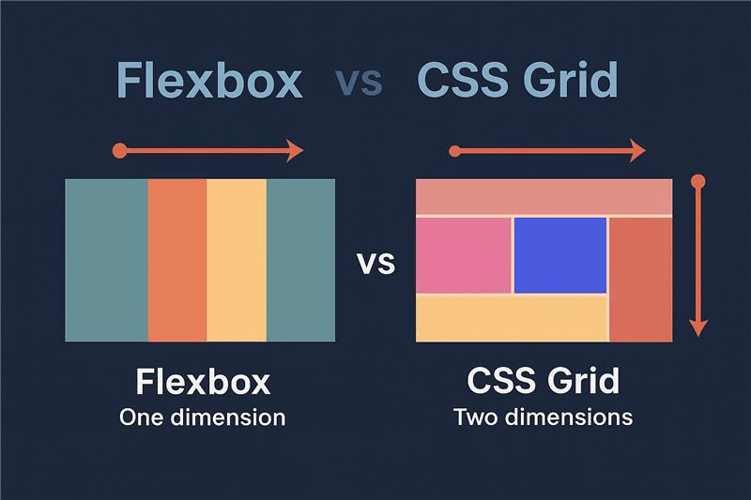
Flexbox vs Grid
Flexbox is 1-dimension
Grid is 2-dimensions
Flexbox is content-driven
Grid is layout-driven

Slide 5
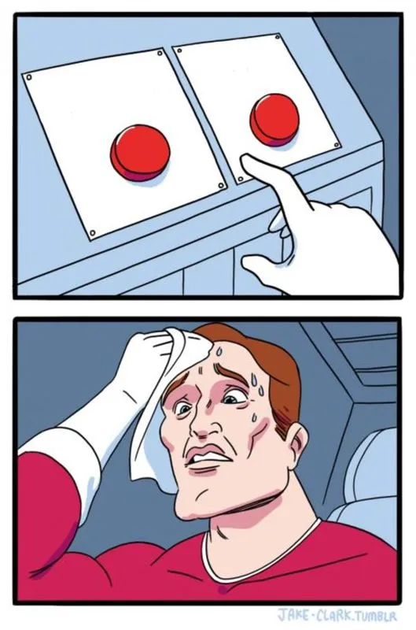
Flexbox vs Grid
Grid
Flexbox
Simple, basic? -------> Flexbox
Complex, Customized? -> Grid
A GENERAL principle to follow
  Use Flexbox at component level
  Use Grid at page level layout

Slide 6
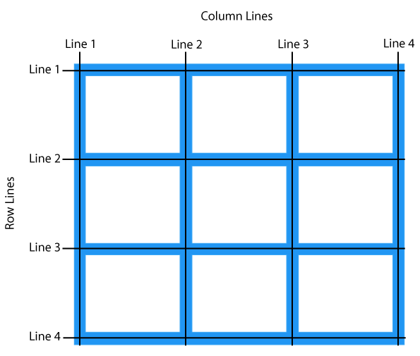
How Does Grid Work?
A grid structure is defined on the container, and each item is given instructions to adapt to the grid
Grid uses lines and tracks, similar to what a spreadsheet looks like

Slide 7
Grid Garden

